Slide 1


Metadata Standards for Genomic Sequence Data
MIxS standards family
Pelin Yilmaz
Microbial Physiology Group, MPI-MM
GSC20
Notes:
Good afternoon everyone. My name is Pelin Yilmaz. I’m a researcher in the Microbial Genomics and Bioinformatics Group at Max Planck Institute for Mar. Microbiology in Bremen. I have been part of the Genomic Standards Consortium, GSC, since 2009, and I’ve been leading the standards projects since 2010.
In my talk, I’ll try to give an overview of Minimum Information about any Sequence, also known as MIxS, standards family. I will focus shortly on the history and development of MIxS, and what they are for, and then I will try to take you through some recent developments that we’ve been working on to make MixS standards more widely available and accessible.

Slide 2
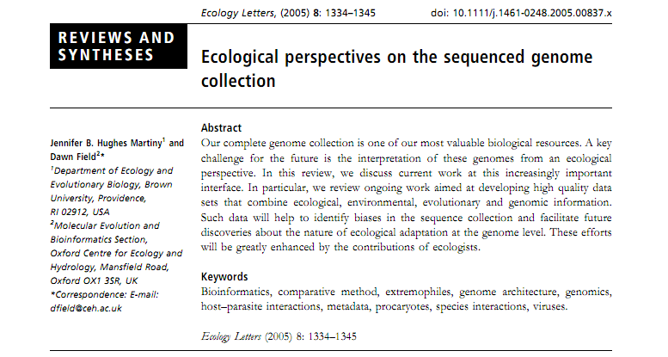
First Steps of GSC
“It is now clear that the full potential of sequence analysis can only be achieved if the geographic and environmental context of the sequence data is considered, herewith referred to as contextual data”
Notes:
So, GSC founding members set out to tackle this increasing sequence numbers problem.
In 2005, dawn field et al. wrote a perspective paper trying and this paper sets the stage for microbial ecology research, and states that contextual metadata is important for understanding sequence data collections
I consider this perspective GSC’s founding paper

Slide 3
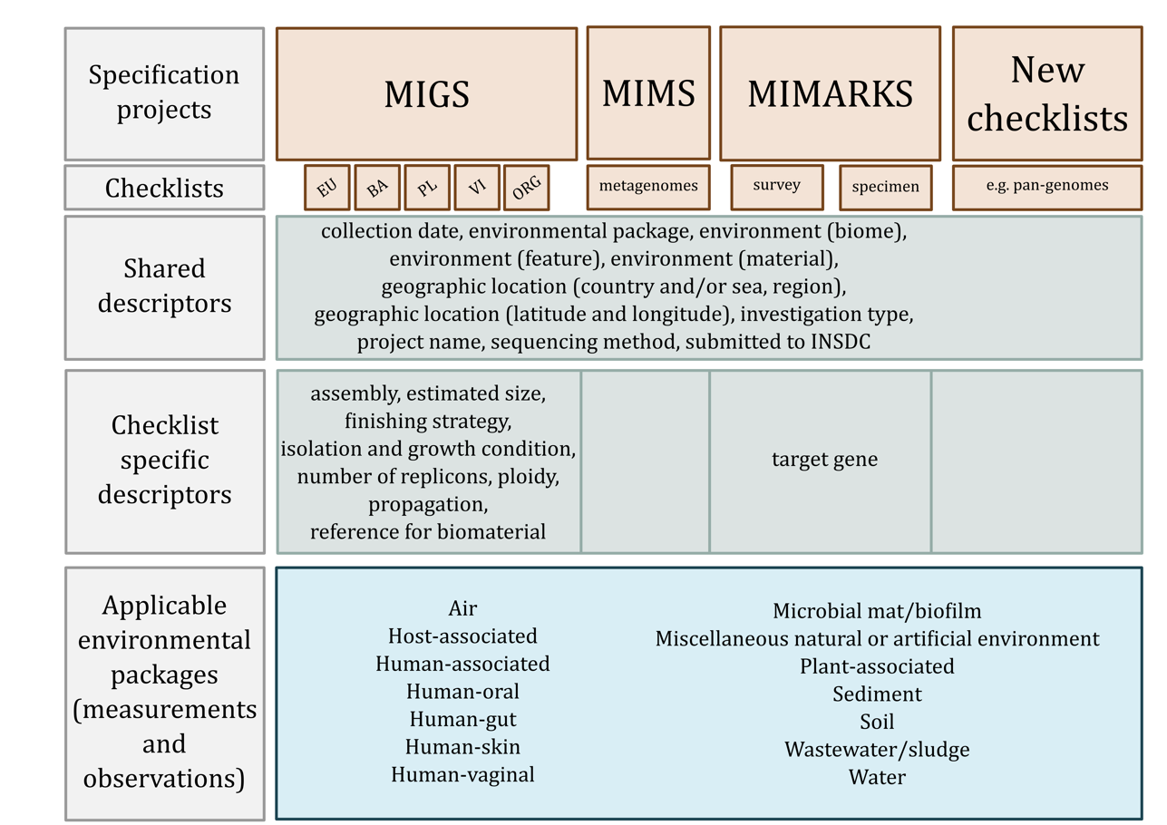
Standards
MIxS
MIxS
Capture geographic and environmental context of sequence data as well as processing parameters
Yilmaz et al. Nat Biotech 2011
Yilmaz et al. ISME J 2011
Notes:
6 years after this perspective paper, we completed the MIxS family of standards, and published them.
(First animation)
When I started my work on mimarks, the gsc already had two published checklists; migs and mims for genomes and metagenomes
(Second animation)
With the development of mimarks, these two standards were extended and improved to cover phylogenetic and functional marker gene sequences as well
(Third animation)
Finally, there is another component called environmental packages, which were introduced during development of mimarks
These packages contain additional environmental and experimental parameters and organize them into large habitat boxes
(Fourth animation)
Finally, an umbrella framework to encompass all current and future gsc checklists was also established
The idea of this framework is that all gsc checklists share a number of contextual data fields, such as geographical coordinates, controlled habitat description or some experimental related fields
Then there are checklist specific fields, which are not shared by all checklists, but are specific to a certain type of sequence. In mimarks, this is for example target gene name
(Fifth animation)
To summarize the GSC checklists; there are currently three of them; migs, mims and mimarks, all collected under the framework of mixs
The goal of these checklists is to provide researchers with a structured and controlled means of enriching any kind of sequence data with environmental, geographic and experimental contextual data

Slide 4
Minimum Information Standards
MIGS/MIMS/MIMARKS/MISAG/MIMAG = MIxS
Requires capturing the geographic and environmental context of the sequence data as well as processing parameters about the sequencing procedure
MIxS are Checklist Standards
Informational job aid
Reduce failure
Helps to ensure consistency and completeness
MIxS are flexible and extensible
Modular structure allows plug-and-play
Range of requirements (mandatory, conditional mandatory, optional)
Public ticketing system for transparent documentation
(https://github.com/GenomicsStandardsConsortium/mixs)
Notes:
Some facts about gsc’s family of minimum standards
With the publication of mimarks, all the gsc checklists were collected under a common concept, termed mixs, to allow better understanding that all the checklists are related, keep the mess to minimum, and to ease extension of standards to other sequence data in future
As I mentioned many now, mixs are checklists. And this concept was preferred because checklists are easy to understand, everyone has a shopping list or to-do list
And since they are easy we hope that consistency and completeness is ensured
Finally, in my opinion the mixs concept is flexible and extansible
Mixs has a modular structure, allowing tailoring of different checklists for diffierent needs and studies
There are a range of requirements, from strict to relaxed, so again fine tuning of which contextual data is submitted depends on the study

Slide 5
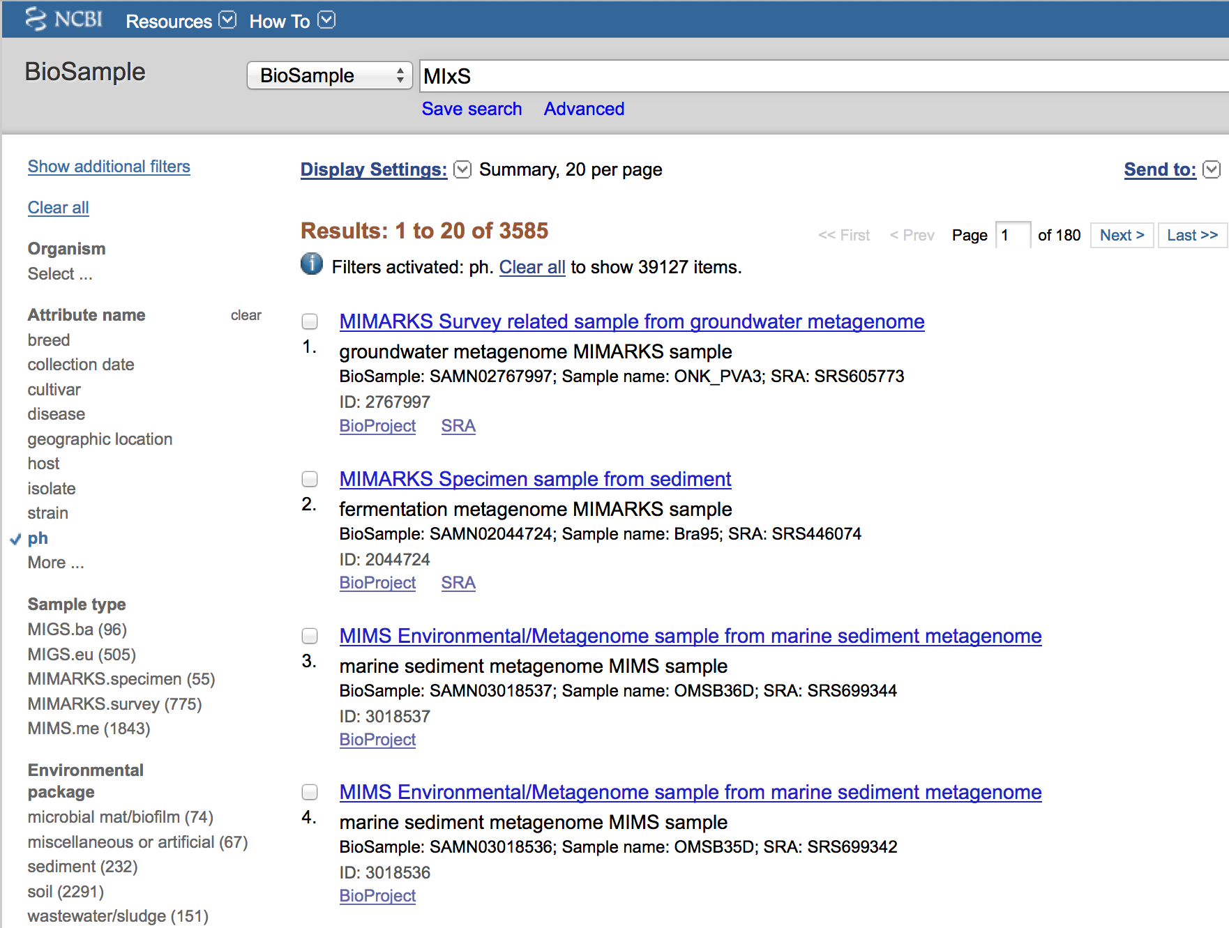
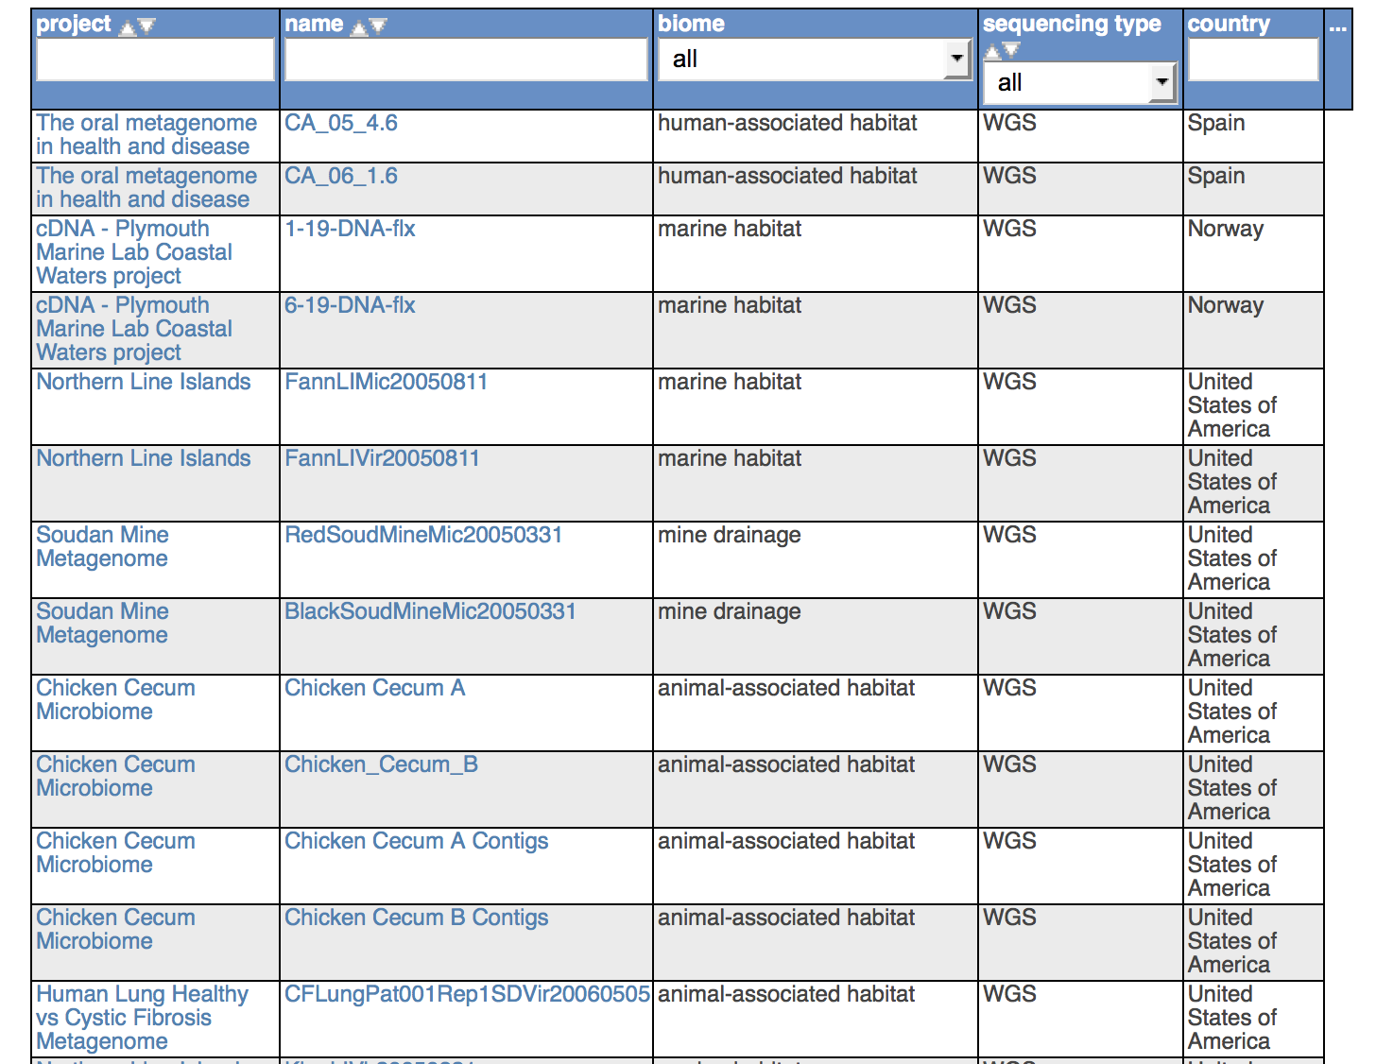
The Effect of Standards
We can find genomes and metagenomes based on habitat, parameters, geographical location…
Notes:
We can find genomes and metagenomes based on habitat, parameters, geographical location…
If you go to any one of the sequence databases, this could be INSDC, or MG-RAST, JGI, you can search projects, samples, and or sequences based on MIxS metadata
And that definitely has made searching and accessing sequence data much easier and convenient

Slide 6
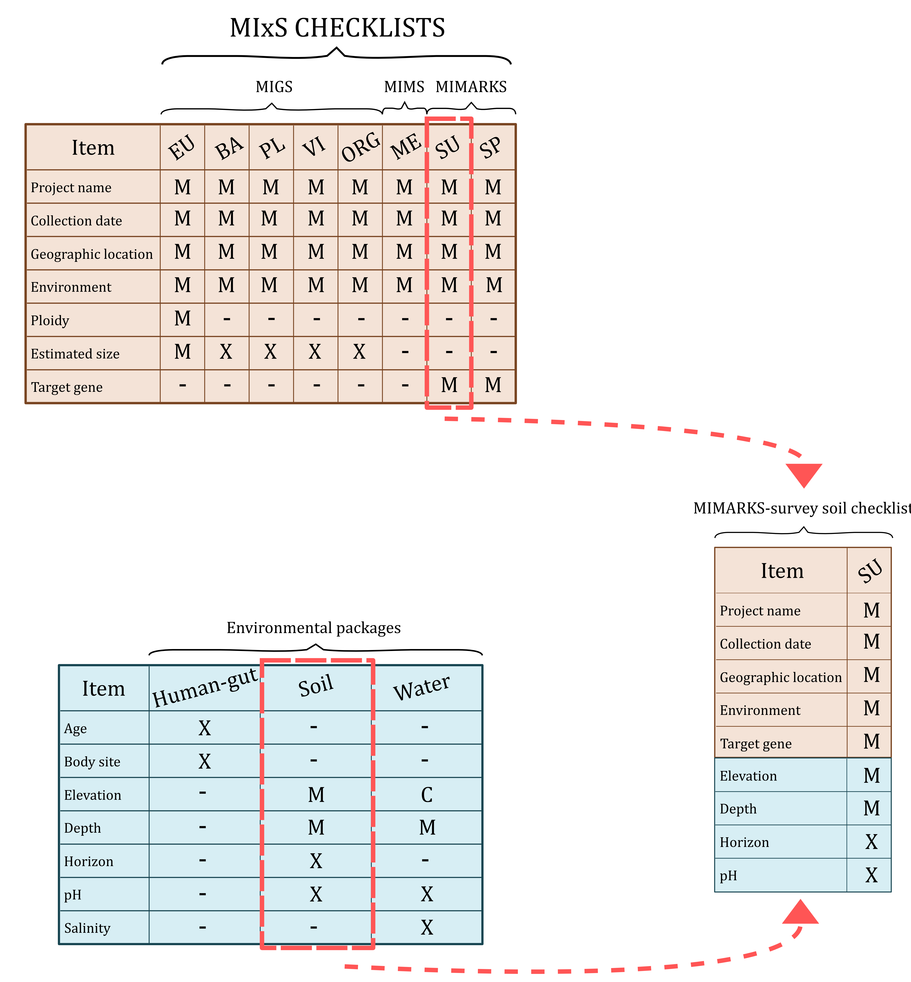
Example Checklist Construction
Notes:
Now let’s look at slightly more technical aspects of how MIxS checklists actually work
Supposing you have taken samples from woodland soil and done rRNA sequencing, if you wanted to fill in metadata for the study you would select
The mimarks survey option, for uncultured organisms,
And complement it with the soil environmental package in order to get a wide range of additional environmental data
And will come up with a mimarks survey soil checklist

Slide 7
Extending MIxS Standards
Modular structure
New checklists
New packages
Notes:
As I mentioned, the idea behind the MIxS framework is that all gsc checklists share a number of metadata fields, such as geographical coordinates, controlled habitat description or some experimental related fields.
Meaning that the MIxS has a modular structure, and can be easily extended by adding new checklists that inherit these shared metadata descriptors, as well as the environmental packages,
Likewise, the MIxS can be extended by just adding new environmental packages, if the need arises.
So far, we have developed, in collaboration with various groups, two new environmental packages, and three new checklists.

Slide 8
Success: MIxS-BE
Development Steps:
-- identify reported metadata from literature, SRA
-- solicit Sloan BE community input
-- formulate initial Built Environment package
-- present initial metadata terms, definitions at GSC meeting
-- coordinate with MIxS working group
-- finalize BE env package
-- procure approve from GSC MIxS group leader
Implementation Steps:
-- distribute to BE community: microbe.net
-- incorporate BE package into MIxS packages
-- utilize BE package to annotate MoBeDAC datasets
environmental package-air
BE Core
BE- building properties
BE - sample properties
In collaboration with Lynn Schriml and MoBeDac

Slide 9
Success: Hydrocarbon Resources
Development Steps:
-- identify reported metadata
-- solicit community input
-- formulate initial Hydrocarbon package
-- present initial metadata terms, definitions at GSC meeting
-- coordinate with MIxS working group
-- finalize HC env package
-- procure approve
environmental package-sediment/water
HC
Core
HC – general properties
HC - production properties
HC – sampling properties
HC – hydrocarbon chemistry
In collaboration with Nicolas Tsesmetzis from Shell

Slide 10
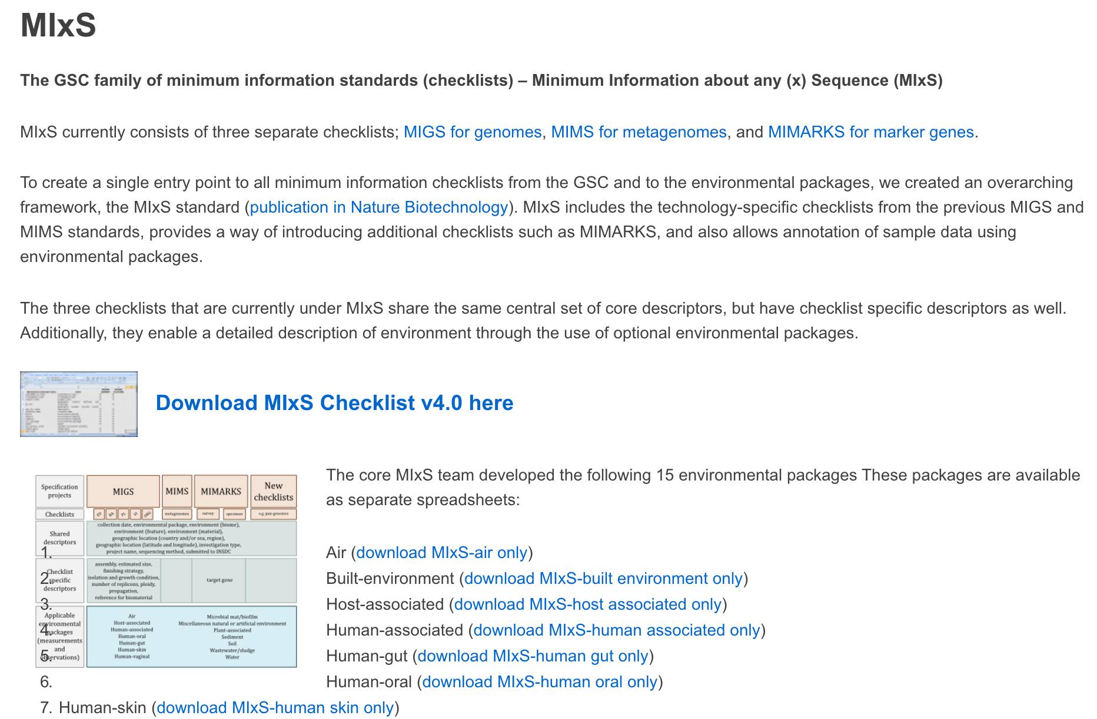
Making MIxS Accessible
Notes:
So with that, I think we have a good overview of how mixs functions, so let’s change gear a bit and take a look at more recent and future developments in mixs that we’re trying to do in order to make the standards more accessible and useful to a wider community.
One of the big issues that we have with mixs is that, it is only available as a csv/txt or spreadsheet file, and in no other format.
This is fine for, say databases like INSDC, mg-rast, etc… as they can just implement the descriptors into their submission systems, but not so much for commnities that might want to extend mixs, or for communities that want to use mixs for linked open data.

Slide 11
Professionalizing MIxS
New MIxS generation
Professional
Accessible
Extensible
Notes:
professional, accessible, extensible (correspond to below points)
Professional by specification
Accessible by docu
Extensible by support software, json
specification, documentation, supporting software

Slide 12
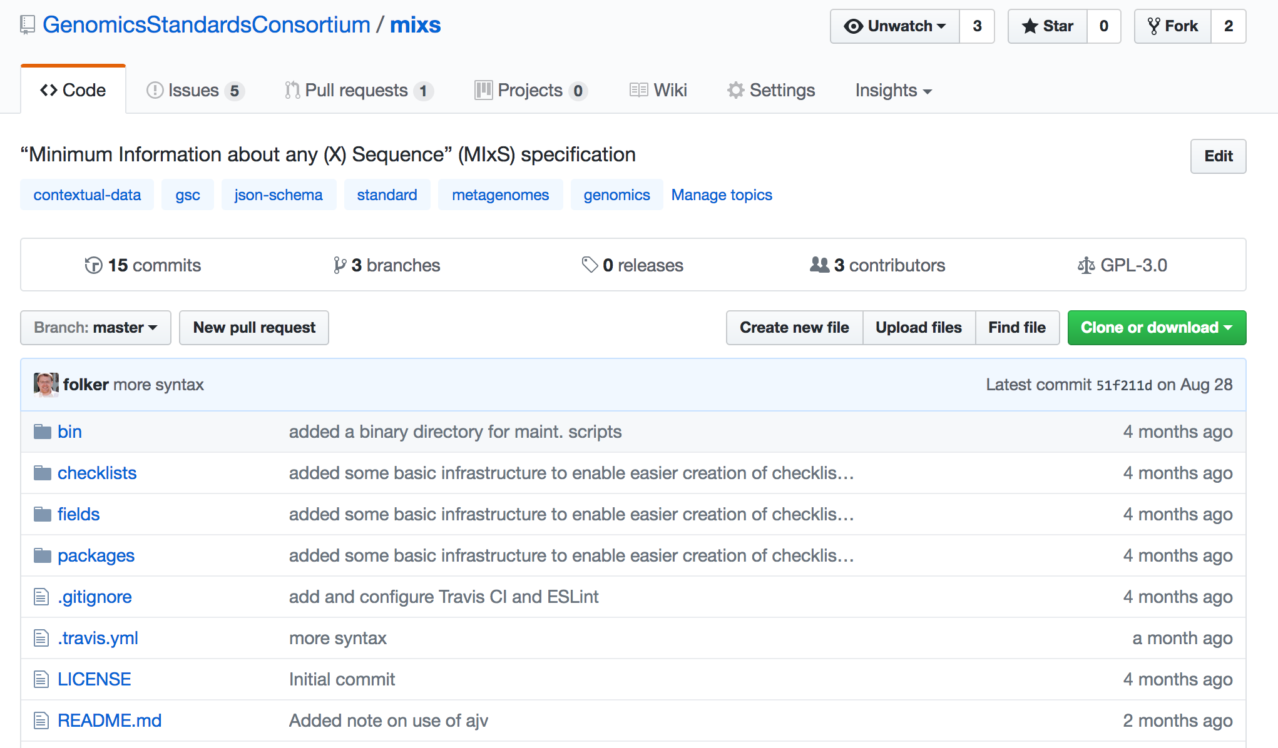
A MIxS GitHub Repo (in progress)
Notes:
As with any github repo, all issues about mixs will be consolidated here, and we are also writing a long and detailed documentary about how to use mixs checklists.
But more importantly, this repo is meant to semi-automatize making mixs extensions and new checklists much easier.
We are envisioning that new mixs extensions and checklists can be done via the forking-merging mechanisms are available in a github repo.
This will hopefully make it much more transparent for developers to work with mixs, and additionally also for us, GSC, to track who is using mixs and how it’s being used.
We are trying to build a system will enable:
- Editing individual metadata fields, i.e description, syntax
- contributing a whole new environmental package/checklist with completely new fields
- Pulling endorsed MIxS combinations for their projects, i.e MIMARKS+soil env package, MIMS+water package
- Pulling profile style MIxS, combining checklists and env. packages in whichever ways they please
- Export options for consumers of MIxS

Slide 13
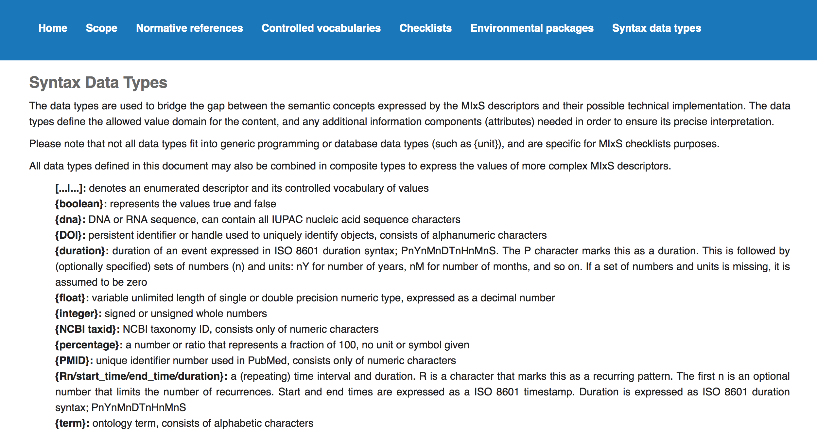
A Better Documentation and Specification

Slide 14
Extensible by reference JSON-Schema
New checklists
New Profiles
New packages
Notes:
As I mentioned, the idea behind the MIxS framework is that all gsc checklists share a number of metadata fields, such as geographical coordinates, controlled habitat description or some experimental related fields.
Meaning that the MIxS has a modular structure, and can be easily extended by adding new checklists that inherit these shared metadata descriptors, as well as the environmental packages,
Likewise, the MIxS can be extended by just adding new environmental packages, if the need arises.
So far, we have developed, in collaboration with various groups, two new environmental packages, and three new checklists.

Slide 15
What is a profile?
Organisms or communities
Characteristics of those organisms
Usual way to construct MIxS=organism/community plus the environment its taken from
Doesn’t fit Plant, as plant is neither host, nor environment
Characteristics of the environments that organisms come from
Make a profile
Item | Plant Checklist
Collection_date | M
Number of replicons | C
Chemical mutagen | C
Fertilizer regimen | C
Soil type | M
Soil pH | M
Leaf count | M
Recycle terms from plant-associated package, and use them as main plant-checklist items
Additional fields from plant-associated package, and completely new fields
Requirements changed

Slide 16
What is a profile?
Each profile can either describe a completely new checklist or a completely new environmental package
A profile can be based on an existing checklist with any number of additional packages
Allow extension i.e. allow to add completely new items (not yet existing in MIxS)
Make use of existing items stricter
make an item which is originally optional mandatory
narrow the defined domain/ value range of an item definition
e.g. if the definition of an existing item contains an enumeration with 5 terms than a profile can delete several of them to only allow a subset of the original term list
e.g. temperature is defined and a profile can only allow for temperature in the range of 50-100 degree Celsius

Slide 17
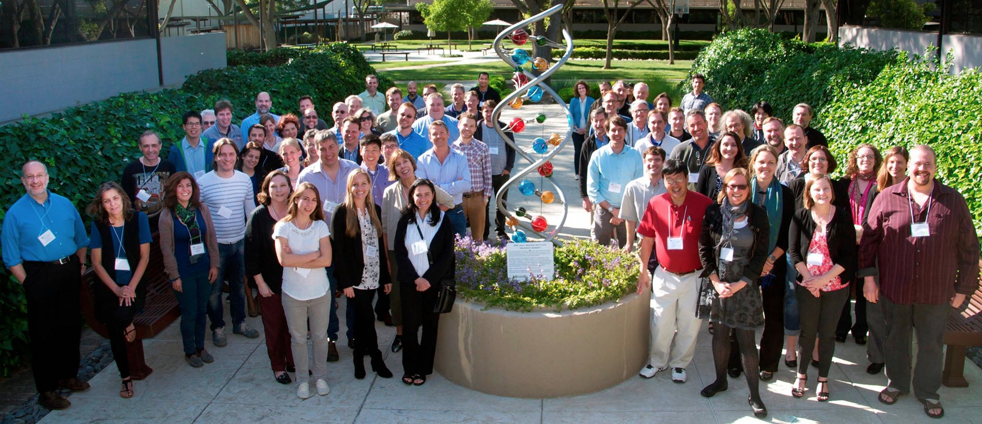
THANK YOU!
Notes:
With that, I would like to thank you for interest in my talk, and apologize for not physically being there. I’m hoping that you enjoyed it.
Pier or myself will try to answer any questions that you might have, and please don’t hesitate to contact me either via GSC or my work contact for further mixs inquiries.

Slide 19
MIxS Release Workflow
Gatekeeper TravisCI
.json
devel
.xlsx
RELEASE!
master
.json

Slide 20
GSC (MIxS) and Other Communities
EnvO
Oceanographic data (M2B3 standard)
NEON
Big Critical Zone Platform
Environmental sciences
MIxS
MIxS
Biodiversity
Biological Collections Ontology
Darwin Core Archive
Access to Biological Collection Data
Biomedical
Bioportal
PATO
Disease Ontology
Human and host related packages

